Slide 1
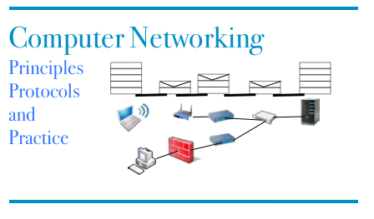
Part 7 Routing protocols
© O. Bonaventure, UCLouvain, 2023. Supplementary material for the Computer Networking : Principles, Protocols and Practice ebook, https://www.computer-networking.info

Slide 2
Agenda
Routing protocols
Distance Vector routing
Link state routing
Routing in IP networks
Interdomain routing

Slide 3

Question
A distance vector router accepts a route towards destination d on link l if any of three conditions is met. What are these three conditions ?
1. d is not already in the routing table
2. d is already in the routing table, but with a shorter path
3. d is already in the routing table, but with a longer path
the sequence number of the distance vector is larger than the previous one
4. d is already in the routing table, but the route was learned from another link than l
5. d is already in the routing table, and the route was learned on link l

Slide 4
Reception of DV
Received(Vector V[],link l)
{ /* received vector from link l */
for each destination=d in V[]
{
if (d isin R[])
{ if ( ((V[d].cost+l.cost) < R[d].cost) OR ( R[d].link == l) )
{ /* better route or change to current route */
R[d].cost=V[d].cost+l.cost;
R[d].link=l;
}
}
else
{ /* new route */
R[d].cost=V[d].cost+l.cost;
R[d].link=l;
}
}

Slide 5


DV sent by R3 to R1 with split horizon?
3
R1
R5
10
R2
R6
9
4
R4
R3
Default link weight is 1

Slide 6
Split horizon
Routing table
A : 0 [ Local ]
D : 1 [South]
B : 3 [South]
C : 3 [South]
E : 2 [South]
Routing table
B : 0 [Local]
A : 3 [South]
C : 1 [East]
E : 1 [South]
D : 2 [South]
Routing table
C : 0 [Local]
E : 1 [South-West]
D : 2 [South-West]
A: 3 [South-West]
B : 1 [West]
A
B
C
Routing table
D : 0 [Local]
A : 1 [North]
E : 1 [East]
C : 2 [East]
B : 2 [East]
A=0
Routing table
E : 0 [Local]
D : 1 [West]
A : 2 [West]
C : 1 [North-East]
B : 1 [North]
D
E
E
A will not pollute D’s routing table

Slide 7
Split horizon (2)
D can also send its distance vector
Routing table
A : 0 [ Local ]
D : 1 [South]
E : ∞
C : ∞
B : ∞
Routing table
B : 0 [Local]
A : 3 [South]
C : 1 [East]
E : 1 [South]
D : 2 [South]
Routing table
C : 0 [Local]
E : 1 [South-West]
D : 2 [South-West]
A: 3 [South-West]
B : 1 [West]
A
B
C
C
Routing table
D : 0 [Local]
A : 1 [North]
E : ∞
C : ∞
B : ∞
D=0;B=∞;C=∞;E=∞
Routing table
E : 0 [Local]
D : 1 [West]
A : 2 [West]
C : 1 [North-East]
B : 1 [North]
D
D
E
E
Does split horizon allows to avoid all counting to infinity problems ?

Slide 8
Limitations of split horizon with poisoning
Routing table
A : 0 [ Local ]
B : ∞ ∞
C : ∞ ∞
E : ∞ ∞
Routing table
B : 0 [Local]
A : 1 [West]
C : 1 [East]
E : 1 [South]
Routing table
C : 0 [Local]
E : 1 [South-West]
A : 2 [West]
B : 1 [West]
A=∞;B=0; C=∞ E=1
A
B
C
C
Routing table
E : 0 [Local]
A : 2 [North]
C : 1 [North-East]
B : 1 [North]
A=∞;B=0; C=1;E=∞
A=2;B=1; C=0;E=∞
E
E

Slide 9
Limitations
Routing table
A : 0 [ Local ]
B : ∞∞
C : ∞ ∞
E : ∞ ∞
Routing table
B : 0 [Local]
A : 1 [West]
C : 1 [East]
E : 1 [South]
Routing table
C : 0 [Local]
E : 1 [South-West]
A : 2 [West]
B : 1 [West]
A
B
C
C
Routing table after B’s vector
E : 0 [Local]
A : ∞
C : 1 [North-East]
B : 1 [North]
Routing table after C’s vector
E : 0 [local]
A : 3 [North-East]
C : 1 [North-East]
B : 1 [North]
A=∞;B=0; C=1;E=∞
A=2;B=1; C=0;E=∞
E
E
E will send its own distance vector
B will discover a new route towards A via E and will advertise it to C
New count to infinity problem

Slide 10
Operational issue
Operation
At each expiration of its 30-sec timer, each router sends its own distance vector and restarts its timer
Problem
After a power failure, all routers might restart at same time and have synchronized timers
Each router will need to process bursts of DV messages
See The Synchronization of Periodic Routing Messages , Floyd, S., and Jacobson, V. IEEE/ACM Transactions on Networking, V.2 N.2, p. 122-136, April 1994.
Notes:
The Synchronization of Periodic Routing Messages , Floyd, S., and Jacobson, V. IEEE/ACM Transactions on Networking, V.2 N.2, p. 122-136, April 1994.

Slide 11
Agenda
Routing protocols
Distance Vector routing
Link state routing
Routing in IP networks
Interdomain routing

Slide 12
Question
Which of the following informations are contained in a link state packet ?
1. sequence number
2. list of paths to reach known destinations
3. list of pairs (known dest, cost)
4. age of the link state packet
5. clock time
6. list of pairs (neighbor, cost to this neighbor)
7. CRC

Slide 13
Link state packet sent by R4 ?
3
R1
R5
10
R2
R6
9
4
R4
R3
Default link weight is 1

Slide 14
How to set link costs ?
By manual configuration
Based on link bandwidth
By measurements
Only strictly positive link weights

Slide 15
Two way connectivity check
Links
A-B, B-A : 1
B-E, E-B : 1
B-C, C-B : 1
E-D, D-E : 1
E-C, C-E : 1
A-D, D-A : 1
LSPs
E-0 [D:1];[B:1];[C:1]
A-0 [D:1];[B:1]
B-0 [A:1] [C:1] [E:1]
C-0 [B:1] [E:1]
D-0 [A:1] [E:1]
Links
A-B, B-A : 1
B-E, E-B : 1
B-C, C-B : 1
E-D, D-E : 1
E-C, C-E : 1
A-D, D-A : 1
LSPs
E-0 [D:1];[B:1];[C:1]
A-0 [D:1];[B:1]
B-0 [A:1] [C:1] [E:1]
C-0 [B:1] [E:1]
D-0 [A:1] [E:1]
Links
A-B, B-A : 1
B-E, E-B : 1
B-C, C-B : 1
E-D, D-E : 1
E-C, C-E : 1
A-D, D-A : 1
LSPs
E-0 [D:1];[B:1];[C:1]
A-0 [D:1];[B:1]
B-0 [A:1] [C:1] [E:1]
C-0 [B:1] [E:1]
D-0 [A:1] [E:1]
LSPs
E-0 [D:1];[B:1];[C:1]
A-0 [D:1];[B:1]
B-0 [A:1] [C:1] [E:1]
C-0 [B:1] [E:1]
D-0 [A:1] [E:1]
A
B
C
C
D
LSP : E-1 [D:1];[C:1]
Links
A-B, B-A : 1
B-E, E-B : 1
B-C, C-B : 1
E-D, D-E : 1
E-C, C-E : 1
A-D, D-A : 1
D
E
E
LSP : E-1 [D:1];[C:1]
LSPs
E-1 [D:1];[C:1]
A-0 [D:1];[B:1]
B-0 [A:1] [C:1] [E:1]
C-0 [B:1] [E:1]
D-0 [A:1] [E:1]
Links
A-B, B-A : 1
B-E, E-B : 1
B-C, C-B : 1
E-D, D-E : 1
E-C, C-E : 1
A-D, D-A : 1
A link is only considered useable only if both directions have been advertised

Slide 16
Transient problems when a link fails
A's FIB
B : East
C : South
D : East
B's FIB
A : West
C : West
D : South
A
B
C
100
D
C's FIB
A : North
B : North
D : North
D's FIB
A : North
B : North
C : North
A and B are not yet aware of failure
Packets will be lost

Slide 17
A detects the failure
A's FIB
B : East
C : South
D : East
B's FIB
A : West
C : West
D : South
A
B
C
100
D
C's FIB
A : North
B : North
D : North
D's FIB
A : North
B : North
C : North
B not yet aware of failure
A cannot reach B/D
Packets continue to be lost

Slide 18
A recomputes Dijkstra and sends its LSP
A's FIB
B : South
C : South
D : South
B's FIB
A : West
C : West
D : South
A
B
A:1 C=1
C
100
D
C's FIB
A : North
B : North
D : North
D's FIB
A : North
B : North
C : North
B not yet aware of failure
A loops towards B/D
Packets continue to be lost

Slide 19
B detects the failure
A's FIB
B : South
C : South
D : South
B's FIB
A : West
C : West
D : South
A
B
A:1 C=1
C
100
D
C's FIB
A : North
B : North
D : North
D's FIB
A : North
B : North
C : North
B cannot reach A/C
A loops towards B/D
Packets continue to be lost

Slide 20
B recomputes Dijkstra and sends its LSP
A's FIB
B : South
C : South
D : South
B's FIB
A : South
C : South
D : South
A
B
B:1 D=1
C
100
D
C's FIB
A : North
B : North
D : North
D's FIB
A : North
B : North
C : North
B cannot reach A/C
A loops towards B/D
Packets continue to be lost

Slide 21
C recomputes Dijkstra
A's FIB
B : South
C : South
D : South
B's FIB
A : South
C : South
D : South
A
B
C
100
D
C's FIB
A : North
B : East
D : East
D's FIB
A : North
B : North
C : North
B loops towards A/C
A can reach everyone
Packets continue to be lost

Slide 22
D recomputes Dijkstra
A's FIB
B : South
C : South
D : South
B's FIB
A : South
C : South
D : South
A
B
C
100
D
C's FIB
A : North
B : East
D : East
D's FIB
A : West
B : North
C : West
B can reach everyone
A can reach everyone
Network has been updated

Slide 23
Router failures
Planned failures
Router reboot to upgrade OS
Sudden failure
due to power outage, software or hardware crash

Slide 24
Comparing routing protocols
Neighbour detection
Detecting link failures
Detecting router failures
Link weights
What information is distributed ?
How often ?
How are forwarding tables built ?

Slide 25
Agenda
Routing protocols
Distance Vector routing
Link state routing
Routing in IP networks
Interdomain routing

Slide 26
Internet routing
Interior Gateway Protocol (IGP)
Routing of IP packets inside each domain
Only knows topology of its domain
Domain4
Domain2
Domain1
Domain3
Exterior Gateway Protocol (EGP)
Routing of IP packets between domains
Each domain is considered as a blackbox

Slide 27
Intradomain routing
Goal
Allow routers to transmit IP packets along the best path towards their destination
best usually means the shortest path
Shortest measured in seconds or hops
sometimes best means the less loaded path
Alternate routes in case of failures
Behavior
All routers exchange routing information

Slide 28
Intradomain routing
Static routing
Only useful in very small domains
Distance vector routing
Routing Information Protocol (RIP)
Still widely used in small domains despite its limitations
Link-state routing
Open Shortest Path First (OSPF)
Widely used in enterprise networks
Intermediate System- Intermediate-System (IS-IS)
Widely used by ISPs

Slide 29
Agenda
Routing Protocols
Routing in IP networks
Routing organization
RIP and OSPF
Interdomain routing

Slide 30
RIP
Distance vector
default period : 30 seconds (with jitter)
distance vector is multicasted in UDP message to all RIP routers in local subnets
Optional extension :
send distance vector after each change
but some links flaps...
send distance vector if routing table changed and did not send another vector within the last 5 seconds
Notes:
RFC2453 RIP Version 2. G. Malkin. November 1998
Gary Malkin, RIP : an intra-domain routing protocol, Addison-Wesley, 2002

Slide 31
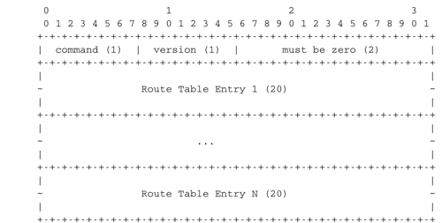
RIP : message format
RIP messages are sent over UDP
port 520

Slide 32
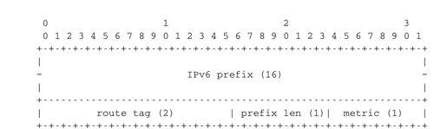
RIP : Route Entries

Slide 33
OSPF
Standard link-state routing protocol for TCP/IP networks (IS-IS in ISP networks)
Builds upon link-state routing with some extensions
Hierarchical routing with areas
Designated routers on subnets
Equal Cost Multipath

Slide 34
OSPF
Operation
HELLO packets to discover neighbors
Update of routing tables
Link state packets
acknowledgements, sequence numbers, age
periodic transmission/ link changes
Database description
Link state Request
used when a router boots to request link state packets from neighbors
Notes:
RFC2328 OSPF Version 2. J. Moy. April 1998.
J. Moy, OSPF: Anatomy of an Internet Routing Protocol, Addison Wesley, 1998

Slide 35
Equal Cost Multipath
R3
R4
R7
R1
R2
R5
R8
RD
R6
R9

Slide 36
Load balancing techniques
Per-packet load balancing
When a router has several equal cost paths to a destination, it sends packets over the different paths using round-robin
Advantage : fair distribution
Drawback: can cause reordering for TCP

Slide 37
Load balancing techniques
Per-flow load balancing
Router identifies layer-4 flows
Hash(IP_{src}, IP_{dest}, Port_{src}, Port_{dest})
Each flow assigned to path based on hash
Advantage : no reordering
Drawback: if elephant flows are sent along same path, unfairness

Slide 38
Agenda
Routing Protocols
Routing in IP networks
Interdomain routing
Routing policies
BGP basics

Slide 39
Interdomain routing
Goals
Allow to transmit IP packets along the best path towards their destination through several transit domains while considering their routing policies of each domain without knowing their detailed topology
From an interdomain viewpoint, best path often means cheapest path
Each domain is free to specify inside its routing policy the domains for which it agrees to provide a transit service and the method it uses to select the best path to reach each destination

Slide 40
Interdomain links
Private link
Usually, a leased line between two routers belonging to the two connected domains
R1
R2
DomainA
DomainB
Notes:
For more information on the organization of the Internet, see :
G. Huston, Peerings and settlements, Internet Protocol Journal, Vol. 2, N1 et 2, 1999, http://www.cisco.com/warp/public/759/ipj_Volume2.html
For more information on interconnection points or Internet exchanges, see :
http://www.euro-ix.net/
http://www.ripe.net/ripe/wg/eix/index.html
http://www.ep.net/ep-main.html

Slide 41
Interconnection exchanges
How to efficiently connect several domains together ?
R2
R3
Physical link
Interdomain link
R1
R4

Slide 42
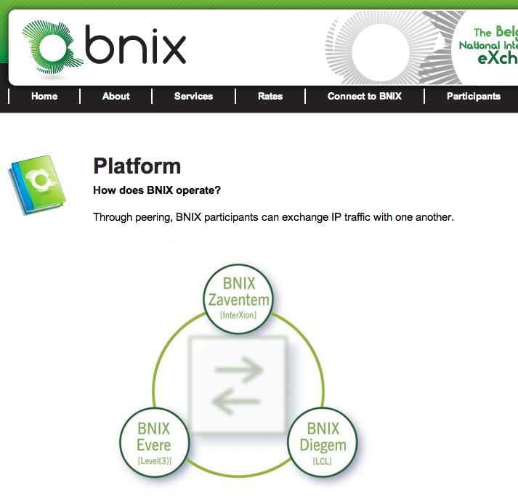
An Internet exchange point

Slide 43
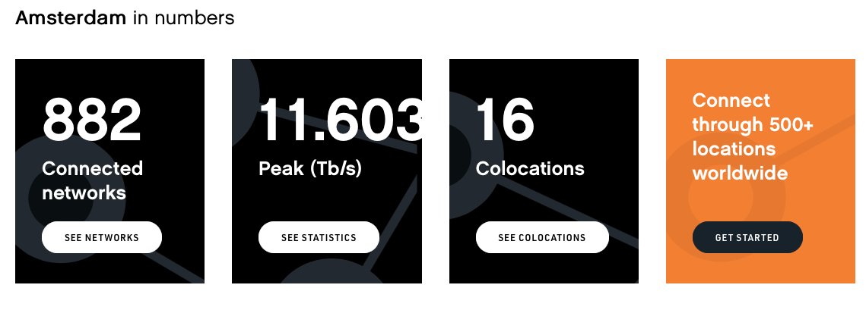
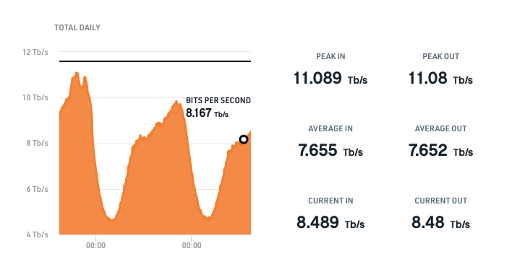
AMS-IX
Largest IX in the world

Slide 44
Routing policies
In theory BGP allows each domain to define its own routing policy...
In practice there are two common policies
customer-provider peering
Customer c buys Internet connectivity from provider P
shared-cost peering
Domains x and y agree to exchange packets without any payment

Slide 45
Customer-provider peering
AS1
AS2
$
$
$
Customer Provider
AS3
AS4
$
$
Principle
Customer sends to its provider internal routes and routes learned from its customers
Provider sends to its customers all known routes
AS7
Notes:
On link AS7-AS4
AS7 advertises its own routes to AS4
AS4 advertises to AS7 the routes that allow to reach the entire Internet
On link AS4-AS2
AS4 advertises its own routes and the routes belonging to AS7
AS2 advertises the routes that allow to reach the entire Internet

Slide 46
Question
AS1
AS2
$
$
$
Customer Provider
AS3
AS4
$
Each AS advertises one prefix (p1 for AS1,...)
Which prefixes are advertised by AS4 to AS2 ?
$
AS7
Which prefixes are advertised by AS4 to AS7 ?

Slide 47
Shared-cost peering
AS1
AS2
$
$
$
Shared-cost
Customer-provider
AS3
AS4
$
$
Principle
PeerX sends to PeerY its internal routes and the routes learned from its own customers
PeerY sends to PeerX its internal routes and the routes learned from its own customers
AS7
Notes:
On link AS3-AS4
AS3 advertises its internal routes
AS4 advertises its internal routes and the routes learned from AS7 (its customer)
On link AS1-AS2
AS1 advertises its internal routes and the routes received from AS3 and AS4 (its customers)
AS2 advertises its internal routes and the routes learned from AS74(its customer)

Slide 48
Question
AS1
AS2
$
$
$
Shared-cost
Each AS advertises one prefix (p1 for AS1,...)
Which prefixes are advertised by AS4 to AS3 ?
Customer-provider
AS3
AS4
$
$
AS7
Which prefixes are advertised by AS2 to AS1 ?

Slide 49
Shared cost peerings
AS3
AS1
AS2
$
$
$
Shared-cost
Each AS advertises one prefix (p1 for AS1,...)
Which prefixes are advertised by AS3 to AS1 ?
AS5
Customer-provider
AS4
$
$
AS7
Which prefixes are advertised by AS1 to AS2 ?

Slide 50
Routing policies
A domain specifies its routing policy by defining on each BGP router two sets of filters for each peer
Import filter
Specifies which routes can be accepted by the router among all the received routes from a given peer
Export filter
Specifies which routes can be advertised by the router to a given peer
Notes:
RFC 2622 Routing Policy Specification Language (RPSL). C. Alaettinoglu, C.
Villamizar, E. Gerich, D. Kessens, D. Meyer, T. Bates, D. Karrenberg,
M. Terpstra. June 1999.
RFC 2650 Using RPSL in Practice. D. Meyer, J. Schmitz, C. Orange, M.
Prior, C. Alaettinoglu. August 1999.
Internet Routing Registries contain the routing policies of various ISPs, see :
http://www.ripe.net/ripencc/pub-services/whois.html
http://www.arin.net/whois/index.html
http://www.apnic.net/apnic-bin/whois.pl

Slide 51
Simple example with RPSL
AS1
AS2
$
$
$
Shared-cost
Customer-provider
AS3
AS4
$
$
Import policy for AS4
Import: from AS3 accept AS3
import: from AS7 accept AS7
import: from AS1 accept ANY
import: from AS2 accept ANY
AS7
Import policy for AS7
Import: from AS4 accept ANY
Export policy for AS4
export: to AS4 announce AS7
Export policy for AS4
export: to AS3 announce AS4 AS7
export: to AS7 announce ANY
export: to AS1 announce AS4 AS7
export: to AS2 announce AS4 AS7

Slide 52
Interdomain paths
AS1
AS2
$
$
$
Shared-cost
Customer-provider
AS3
AS4
$
Each AS advertises one prefix (p1 for AS1,...)
Which path will be used from AS7 to AS2 ?
$
AS7
Which path will be used from AS3 to AS2 ?

Slide 53
Agenda
Routing in IP networks
Interdomain routing
Routing policies
eBGP basics
BGP convergence

Slide 54
Border Gateway Protocol
Path vector protocol
BGP router advertises its best route to each destination
prefix: 2001:db8:1/48 ASPath: AS1
AS5
2001:db8:1/48
AS1
AS2
prefix: 2001:db8:1/48 ASPath: ::AS2:AS4:AS1
prefix:2001:db8:1/48
ASPath: AS1
prefix: 2001:db8:1/48
ASPath: AS4:AS1
AS4
... with incremental updates

Slide 55
BGP : Principles
Principles
BGP relies on the incremental exchange of path vectors
BGP session established over TCP connection between peers
AS3
R1
BGP
session
Each peer sends all its active routes
BGP Msgs
R2
AS4
As long as the BGP session remains up
Incrementally update BGP routing tables

Slide 56
BGP basics
2 types of BGP messages
UPDATE (path vector)
advertises a route towards one prefix
Destination address/prefix
Interdomain path (AS-Path)
Nexthop
WITHDRAW
a previously announced route is not reachable anymore
Unreachable destination address/prefix

Slide 57
BGP router
BGP Adj-RIB-In
BGP Loc-RIB
Peer[N]
All
acceptable routes
BGP Adj-RIB-Out
BGP Msgs from Peer[N]
BGP Msgs to Peer[N]
Peer[1]
Peer[N]
BGP Msgs from Peer[1]
Import filter
Attribute
manipulation
BGP Decision Process
Peer[1]
Export filter
Attribute
manipulation
BGP Msgs to Peer[1]
Import filter(Peer[i])
Determines which BGM Msgs are acceptable from Peer[i]
One best
route to each
destination
Export filter(Peer[i])
Determines which routes can be sent to Peer[i]
BGP Routing Information Base
Contains all the acceptable routes learned from all Peers + internal routes
BGP decision process selects the best route towards each destination

Slide 58
Example
UPDATE
prefix: 2001:db8:12/48,
NextHop:R1
ASPath: AS10
UPDATE
prefix: 2001:db8:12/48,
NextHop:R2
ASPath: AS20:AS10
AS10
AS30
AS20
R1
BGP
R2
R3
2001:db8:12/48
BGP
BGP
UPDATE
prefix: 2001:db8:12/48,
NextHop:R1
ASPath: AS10
UPDATE
prefix: 2001:db8:12/48,
NextHop:R4
ASPath: AS40:AS10
R4
AS40
What happens if link AS10-AS20 goes down ?
What happens if link AS10-AS40 goes down ?
Notes:
If link AS10-AS20 goes down, AS20 will not consider anymore the path learned from AS10. It will thus remove this path from its routing table and will instead select the path learned from AS40. This will force AS20 to send the following UPDATE to AS30 :

Slide 59
How to prefer some routes over others ?
RA
AS2
RB
Backup: 2Mbps
Primary: 34Mbps
R1
AS1

Slide 60
BGP router
BGP RIB
All
acceptable routes
Peer[N]
Peer[N]
BGP Msgs from Peer[N]
BGP Msgs to Peer[N]
Peer[1]
BGP Decision Process
Peer[1]
Import filter
Attribute
manipulation
Export filter
Attribute
manipulation
BGP Msgs from Peer[1]
BGP Msgs to Peer[1]
One best
route to each
destination
Import filter
Selection of acceptable routes
Addition of local-pref attribute inside received BGP Msg
Normal quality route : local-pref=100
Better than normal route :local-pref=200
Worse than normal route :local-pref=50
Simplified BGP Decision Process
Select routes with highest local-pref
If there are several routes, choose routes with the shortest ASPath
If there are still several routes tie-breaking rule

Slide 61
BGP session
Session establishment
def initialize_BGP_session( RemoteAS, RemoteIP):
# Initialize and start BGP session
# Send BGP OPEN Message to RemoteIP on port 179
# Follow BGP state machine
# advertise local routes and routes learned from peers*/
for d in BGPLocRIB :
B=build_BGP_Update(d)
S=Apply_Export_Filter(RemoteAS,B)
if (S != None) :
send_Update(S,RemoteAS,RemoteIP)
# entire RIB has been sent
# new Updates will be sent to reflect local or distant
# changes in routers

Slide 62
Simple export filter
def apply_export_filter(RemoteAS, BGPMsg) :
# check if RemoteAS already received route
if RemoteAS is BGPMsg.ASPath :
BGPMsg=None
# Many additional export policies can be configured :
# Accept or refuse the BGPMsg
# Modify selected attributes inside BGPMsg
return BGPMsg

Slide 63
Simple import filter
def apply_import_filter(RemoteAS, BGPMsg):
if MysAS in BGPMsg.ASPath :
BGPMsg=None
# Many additional import policies can be configured :
# Accept or refuse the BGPMsg
# Modify selected attributes inside BGPMsg
return BGPMsg

Slide 64
Processing UPDATE
def Recvd_BGPMsg(Msg, RemoteAS) :
B=apply_import_filer(Msg,RemoteAS)
if (B== None): # Msg not acceptable
return
if IsUPDATE(Msg):
Old_Route=BestRoute(Msg.prefix)
Insert_in_RIB(Msg)
Run_Decision_Process(RIB)
if (BestRoute(Msg.prefix) != Old_Route) :
# best route changed
B=build_BGP_Message(Msg.prefix);
S=apply_export_filter(RemoteAS,B);
if (S!=None) : # announce best route
send_UPDATE(S,RemoteAS,RemoteIP);
else if (Old_Route != None) :
send_WITHDRAW(Msg.prefix,RemoteAS, RemoteIP)

Slide 65
Processing WITHDRAW
else : # Msg is WITHDRAW
Old_Route=BestRoute(Msg.prefix)
Remove_from_RIB(Msg)
Run_Decision_Process(RIB)
if (Best_Route(Msg.prefix) !=Old_Route):
# best route changed
B=build_BGP_Message(Msg.prefix)
S=apply_export_filter(RemoteAS,B)
if (S != None) : # still one best route towards Msg.prefix
send_UPDATE(S,RemoteAS, RemoteIP);
else if(Old_Route != None) : # No best route anymore
send_WITHDRAW(Msg.prefix,RemoteAS,RemoteIP);

Slide 66
Simple example
AS2
AS1
AS3
AS4
AS1 announces one prefix, p
No routing policies
AS5
How many routes in AS5?
How many routes in AS4?
Notes:
Due to the utilization of the local-pref attribute, some paths on the Internet are longer than their optimum length, see :
Lixin Gao and Feng Wang , The Extent of AS Path Inflation by Routing Policies, GlobalInternet 2002

Slide 67
Simple example
p AS1
AS2
p AS2:AS1
RIB
p AS2:AS1 (best)
p AS4:AS1
AS1
AS3
p AS4:AS1
p AS3:AS2:AS1
p AS1
AS4
AS1 announces one prefix, p
No routing policies
RIB
p AS3:AS2:AS1
p AS1 (best)
Notes:
Due to the utilization of the local-pref attribute, some paths on the Internet are longer than their optimum length, see :
Lixin Gao and Feng Wang , The Extent of AS Path Inflation by Routing Policies, GlobalInternet 2002

Slide 68
Another example
p AS1
AS2
p AS2:AS1
AS1
AS3
AS1 announces one prefix, p
No routing policies
Links are activated in the following order
AS1-AS2, AS3-AS4, AS2-AS3, AS1-AS3
p AS1
p AS3:AS2:AS1
AS4
What will AS3 when receiving this update ?
Notes:
Due to the utilization of the local-pref attribute, some paths on the Internet are longer than their optimum length, see :
Lixin Gao and Feng Wang , The Extent of AS Path Inflation by Routing Policies, GlobalInternet 2002

Slide 69
How to prefer routes ?
RA
AS2
RB
Backup: 2Mbps
Primary: 34Mbps
R1
AS1
RPSL-like policy for AS1
aut-num: AS1
import: from AS2 RA at R1 set localpref=100;
from AS2 RB at R1 set localpref=200;
accept ANY
export: to AS2 RA at R1 announce AS1
to AS2 RB at R1 announce AS1
RPSL-like policy for AS2
aut-num: AS2
import: from AS1 R1 at RA set localpref=100;
from AS1 R1 at RB set localpref=200;
accept AS1
export: to AS1 R1 at RA announce ANY
to AS2 R1 at RB announce ANY
Notes:
Note that in RPSL, the set localpref construct does not exist. It is replaced with action preference=x. Unfortunately, in RPSL the routes with the lowest preference are preferred. RPSL uses thus the opposite of local-pref....

Slide 70
How to prefer routes ?
RA
RB
AS3
AS2
R3
Expensive
R5
AS5
AS1
Cheap
R2
AS4
R1
RPSL policy for AS1
aut-num: AS1
import: from AS2 RA at R1 set localpref=100;
from AS4 R2 at R1 set localpref=200;
accept ANY
export: to AS2 RA at R1 announce AS1
to AS4 R2 at R1 announce AS1
AS1 will prefer to send over cheap link
But the flow of the packets destined to AS1 will depend on the routing policy of the other domains

Slide 71
Agenda
Routing in IP networks
Interdomain routing
Routing policies
eBGP basics
BGP convergence

Slide 72
Limitations of local-pref
In theory
Each domain is free to define its order of preference for the routes learned from external peers
How to reach 2001:db8:1/48 from AS3 and AS4 ?
2001:db8:1/48
AS1
Preferred paths for AS3
1. AS4:AS1
2. AS1
Preferred paths for AS4
1. AS3:AS1
2. AS1
AS3
AS4

Slide 73
Limitations of local-pref
AS1 sends its UPDATE messages ...
2001:db8:1/48
UPDATE
P: 2001:db8:1/48
ASPath: AS1
UPDATE
P: 2001:db8:1/48
ASPath: AS1
AS1
AS3
AS4
Preferred paths for AS4
1. AS3:AS1
2. AS1
Preferred paths for AS3
1. AS4:AS1
2. AS1
Routing table for AS3
2001:db8:1/48 ASPath: AS1 (best)
Routing table for AS4
2001:db8:1/48 ASPath: AS1 (best)

Slide 74
Limitations of local-pref
First possibility
AS3 sends its UPDATE first...
2001:db8:1/48
AS1
Preferred paths for AS4
1. AS3:AS1
2. AS1
Preferred paths for AS3
1. AS4:AS1
2. AS1
AS3
AS4
Routing table for AS3
2001:db8:1/48 ASPath: AS1 (best)
Routing table for AS4
2001:db8:1/48 ASPath: AS1
2001:db8:1/48 ASPath:AS3:AS1 (best)
UPDATE
P: 2001:db8:1/48
ASPath: AS3:AS1
Stable route assignment

Slide 75
Limitations of local-pref
AS4 sends its UPDATE first...
2001:db8:1/48
AS1
Preferred paths for AS4
1. AS3:AS1
2. AS1
Preferred paths for AS3
1. AS4:AS1
2. AS1
AS3
AS4
Routing table for AS3
2001:db8:1/48 ASPath: AS1
2001:db8:1/48 ASPath: AS4:AS1 (best)
Routing table for AS4
2001:db8:1/48 ASPath: AS1 (best)
UPDATE
Prefix: 2001:db8:1/48
ASPath: AS4:AS1
Another (but different) stable route assignment

Slide 76
Limitations of local-pref
AS3 and AS4 send their UPDATE together...
2001:db8:1/48
AS1
Preferred paths for AS4
1. AS3:AS1
2. AS1
Preferred paths for AS3
1. AS4:AS1
2. AS1
AS3
AS4
UPDATE
P: 2001:db8:1/48
ASPath: AS3:AS1
UPDATE
P: 2001:db8:1/48 ASPath: AS4:AS1
AS3 prefers indirect path -> withdraw
AS4 prefers indirect path -> withdraw

Slide 77
Limitations of local-pref
AS3 and AS4 send their UPDATE together...
2001:db8:1/48
Preferred paths for AS3
1. AS4:AS1
2. AS1
Preferred paths for AS4
1. AS3:AS1
2. AS1
AS1
AS3
AS4
WITHDRAW
P: 2001:db8:1/48
WITHDRAW
P: 2001:db8:1/48
AS3 : indirect route is not available anymore
AS3 will reannounce its direct route...
AS4 : indirect route is not available anymore
AS4 will reannounce its direct route...

Slide 78
More limitations local pref
Unfortunately, interdomain routing may not converge at all in some cases...
How to reach a destination inside AS0 in this case ?
Preferred paths for AS1
1. AS3:AS0
2. other paths
AS1
Preferred paths for AS4
1. AS1:AS0
2. other paths
Preferred paths for AS3
1. AS4:AS0
2. other paths
AS0
AS3
AS4
Notes:
In practice, the exchange of BGP UPDATE messages will cease due to the utilization of timers by BGP routers and the routing will stabilize on one of the two stable route assignments.

Slide 79
Simple example
Shared-cost
$
AS2
Customer-provider
AS1 announces one prefix, p
$
AS1
AS3
Notes:
Due to the utilization of the local-pref attribute, some paths on the Internet are longer than their optimum length, see :
Lixin Gao and Feng Wang , The Extent of AS Path Inflation by Routing Policies, GlobalInternet 2002

Slide 80
Simple example
Shared-cost
$
Customer-provider
AS2
$
AS1
AS3
$
$
AS4
AS1 announces one prefix, p
AS5
Notes:
Due to the utilization of the local-pref attribute, some paths on the Internet are longer than their optimum length, see :
Lixin Gao and Feng Wang , The Extent of AS Path Inflation by Routing Policies, GlobalInternet 2002

Slide 81
Simple example
Shared-cost
$
Customer-provider
AS2
$
AS1
AS3
$
$
AS4
$
AS1 announces one prefix, p
AS1-AS2 or AS2-AS4 fails
AS5
Notes:
Due to the utilization of the local-pref attribute, some paths on the Internet are longer than their optimum length, see :
Lixin Gao and Feng Wang , The Extent of AS Path Inflation by Routing Policies, GlobalInternet 2002

Slide 82
Simple example
Shared-cost
$
Customer-provider
AS2
$
AS1
AS3
$
$
AS4
AS1 announces one prefix, p
AS3-AS4 is initially down and then comes up
Notes:
Due to the utilization of the local-pref attribute, some paths on the Internet are longer than their optimum length, see :
Lixin Gao and Feng Wang , The Extent of AS Path Inflation by Routing Policies, GlobalInternet 2002

Slide 83
local-pref and economic relations
In practice, local-pref is often combined with filters to enforce economical relationships
Prov1
Prov2
$
$
Peer3
Peer1
AS1
Peer2
Peer4
$
$
Cust1
Cust2
Shared-cost
Local-pref values used by AS1
> 1000 for the routes received from a Customer
500 – 999 for the routes learned from a Peer
< 500 for the routes learned from a Provider
$
Customer-provider
Notes:
This local-pref settings corresponds to the economical relationships between the various ASes.
Since AS1 is paid to carry packets towards Cust1 and Cust2, it will select a route towards those networks whenever possible.
Since AS1 does not need to pay to carry packets towards Peer1-4, AS1 will select a route towards those networks whenever possible.
AS1 will only utilize the routes receive from its providers when there is no other choice.
It is shown in the following papers that this way of utilizing the local-pref attribute leads to stable BGP routes :
Lixin Gao, Timothy G. Griffin, and Jennifer Rexford, "Inherently safe backup
routing with BGP," Proc. IEEE INFOCOM, April 2001
Lixin Gao and Jennifer Rexford, "Stable Internet routing without global
coordination," IEEE/ACM Transactions on Networking, December 2001, pp.
681-692
The RPSL policy of AS1 could be as follows :
RPSL policy for AS1
aut-num: AS1
import: from Cust1 action set localpref=200; accept Cust1
from Cust2 action set localpref=200; accept Cust2
from Peer1 action set localpref=150; accept Peer1
from Peer2 action set localpref=160; accept Peer2
from Peer3 action set localpref=170; accept Peer3
from Peer4 action set localpref=180; accept Peer4
from Prov1 action set localpref=100; accept ANY
from Prov2 action set localpref=100; accept ANY

Slide 84
local-pref
Which route will be used by AS1 to reach AS5 ?
and how will AS5 reach AS1 ?
AS2
$
AS1
AS3
$
$
$
AS4
AS8
$
$
Shared-cost
AS6
$
Customer-provider
AS5
$
AS7
$
Internet paths are often asymmetrical
Notes:
Due to the utilization of the local-pref attribute, some paths on the Internet are longer than their optimum length, see :
Lixin Gao and Feng Wang , The Extent of AS Path Inflation by Routing Policies, GlobalInternet 2002

Slide 85
Internet 1990s
NSFNet
American backbone
AUP : no commercial traffic
Some regional networks
US regions
national networks in Europe
Universities/research labs
connected to regional networks or directly to NSFNet

Slide 86
Internet early 2000s
Tier-1 ISPs
Dozen transit ISPs shared-cost
Uunet, Level3, OTIP, ...
Tier-2 ISPs
Regional/ National ISPs
Tier-3 ISPs
Smaller ISPs, Entreprise Networks, Content providers
Customers of T2 or T1 ISPs
shared-cost with other T3 ISPs
Notes:
See :
L. Subramanian, S. Agarwal, J. Rexford, and RH Katz. Characterizing the Internet hierarchy from multiple vantage points. In IEEE INFOCOM, 2002

Slide 87
Today’s Internet
Hyper Giants
google, microsoft, yahoo, amazon, ...
google peers 70% ISPs
Tier-1 ISPs
Tier-2 ISPs
Tier-3 ISPs
Many peerings at IXPs
Craig Labovitz), Scott Iekel-Johnson, Danny McPherson, Jon Oberheide, Farnam Jahanian, Internet Inter-Domain Traffic, SIGCOMM 2010

Slide 88
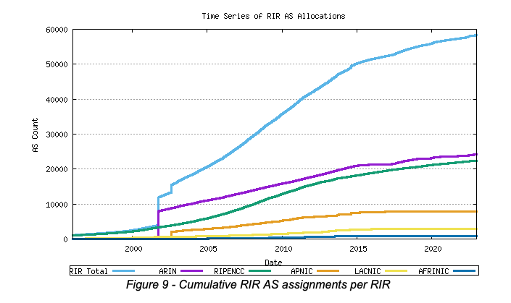
Internet size #AS
Source: http://bgp.potaroo.net

Slide 89
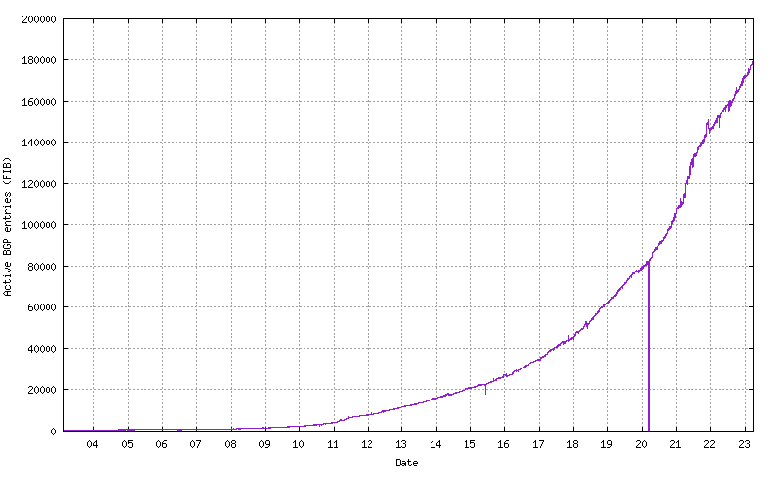
BGP IPv6 routing tables
Source: http://bgp.potaroo.net

Slide 90
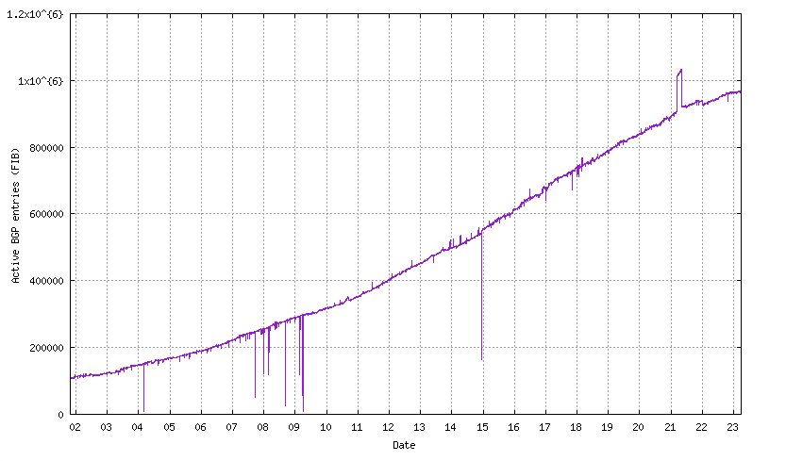
BGP : IPv4 routing tables
Source: http://bgp.potaroo.net

Slide 91
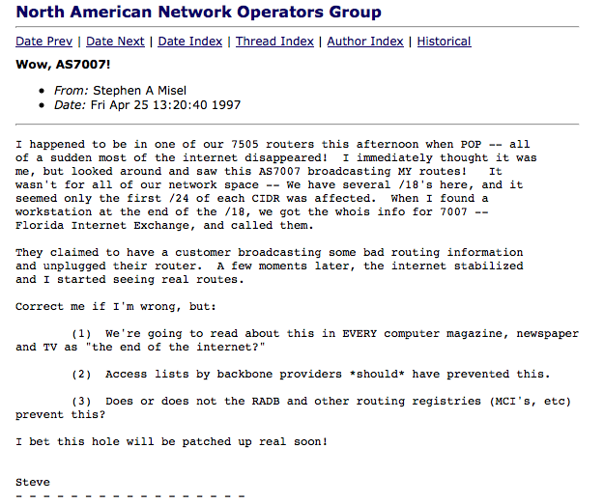

AS7007 incident

Slide 92
RIPE RIS
https://stat.ripe.net/AS2611#tabId=at-a-glance
https://stat.ripe.net/widget/looking-glass#w.resource=2001:6a8::/32
https://stat.ripe.net/2001:6A8::/32#tabId=routing

Slide 93
Youtube and Pakistan
http://www.ripe.net/internet-coordination/news/industry-developments/youtube-hijacking-a-ripe-ncc-ris-case-study

